Slide 1
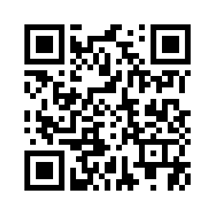
Welcome to Arno Kindergarten
We are excited to welcome your child to the Arno school family! Kindergarten is a very important and special year in your child’s development. We are glad you are here today to learn more about what to expect!
http://arnofamily.edublogs.org/

Slide 2
About Arno
Office Staff
Principal: Stephen Zielinski- zielinski@appublicschools.com
Secretary: Cathy Anderson- canderson@appublicschools.com
Student Advocate: Kim Dowd- dowd@appublicschools.com
General Information
School Hours: 8:30-3:30
Arno Blog: arnofamily.edublogs.org
Phone- 313-827-1050
Support Services
Resource Room- Michelle Sbonek
Social Work- Sandy Bennett
Speech and Language- Andrea Alvarez

Slide 3
About Arno
General Information
Lunch-
Kindergarten lunch time is 11:00-11:40 20 (eat)/20 (recess)
Hot Lunch, Salad Bar, and PB & J are available for purchase
District Lunch Info
Parent Connect- Link
A web program that allows parents to view information about their child.
Title 1/31A-
Academic Support for those who qualify in reading and math

Slide 4
About Arno
First Day Info-
You will receive a Welcome letter in August!
Arrival Procedure- Line up by class at Door
Dismissal Procedure- Parents line up to receive your child
Busses- Red/Blue Bus- Please watch for more info in August
**Please let the office know if your child will not be taking the bus
Latchkey- More Info
Available every school day in session
Hours: 7:00-8:30/3:30-6:00

Slide 5
Medical
Please inform us of any medical issues your child may have.
Our student advocate can give both prescription and over-the-counter medications.
Must have medication permit form for each medication.
Medication must be in child’s name and in the original container
Parents need to transport all medications

Slide 6
Specials
Kindergarten students attend 5 specials a week plus book checkout:
Gym
Art
Music
Media/Book Check Out
Media Technology

Slide 7
Kindergarten Expectations
Academics
Reading: identify letters and sounds, read simple sentences and books with several sentences per page, “sound out” words, comprehend stories
Mathematics: count to 100, identify and describe shapes, add and subtract, identify numbers, patterning Writing: Write first and last name, writes simple words, spells other words phonetically, writes 1-2 simple sentences with support

Slide 8
Kindergarten Expectations
Social/Emotional
Take turns, use conflict resolution to solve problems, share with others, self-control, exhibit positive behavior towards others
Fine/Gross Motor Skills
Proper pencil and scissor grip, body control
...and so much more!

Slide 9
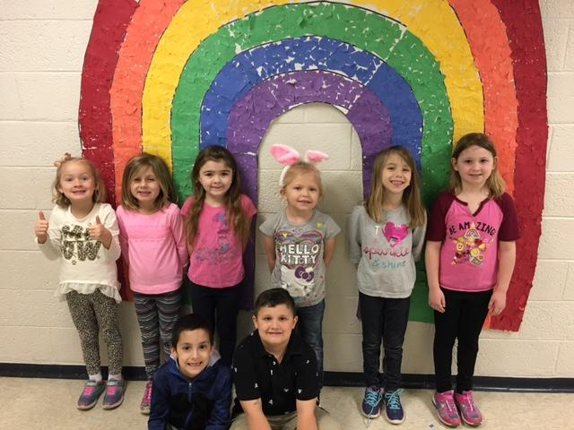
Positive Behavior Support
Positive Behavior Support Program
Implemented in grades K-5
Students learn about positive choices, and are rewarded for making them!
Cougar Cash
PBIS Reward Days
Super Cougar Lunch

Slide 10
Young 5s or Kindergarten?
Who might be a good fit for Young 5s?
Students with birthdays between July 1 and November 30
Recommendation from preschool teacher or parent for an additional year of development
Need for social-emotional development
All students screened with Brigance tool - information will be used to recommend best placement

Slide 11
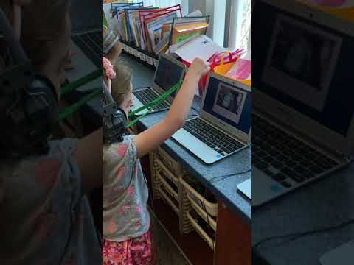
Kinder Tech
Our kindergarteners enjoy accessing technology to enhance their learning

Slide 12
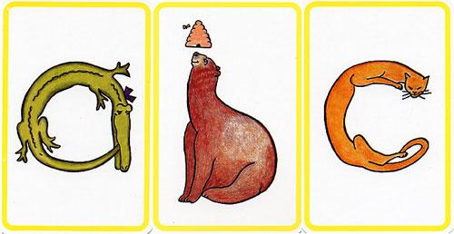
Zoo Phonics
Alphabet letter recognition and sound production with the use of animals and movement
Utilizes visual, auditory, and kinesthetic learning styles
Other Literacy Skills Practiced:
Blending sounds into words
Segmenting sounds to identify beginning, middle, and ending sounds in words
Rhyming words
Substituting or adding sounds to words to make new words
Notes:
** Learn animal names and motion first
** Learn sound that animal makes
** Learn where the animal lives (Allie Alligator lives in letter A)
** We use Beanie babies/flash cards/songs/games to teach these
** By Nov/Dec. We are starting to blend CV syllables together (with use of Beanie babies)
** By Dec./Jan. We are starting to blend CVC words together ( with use of beanie babies)
** Other things learned through Phonics…. Long vowels, silent E, diagraphs SH/CH/TH

Slide 13
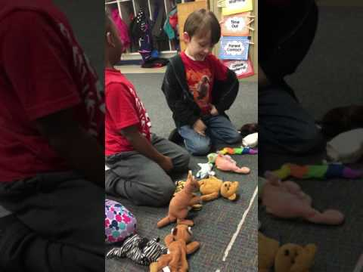
Zoo Phonics in Action

Slide 14
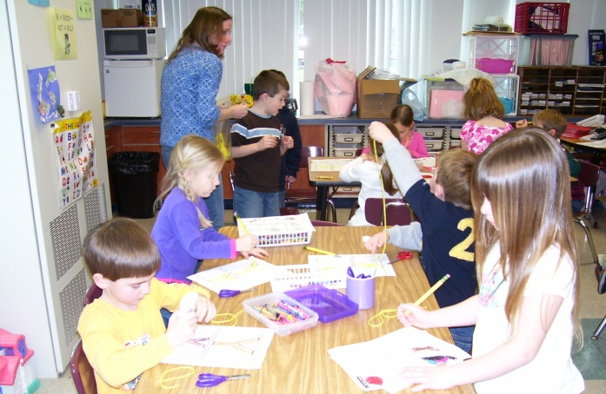
Volunteers
Classroom volunteers work with our children in a variety of ways
One on one
Small groups
To prepare classroom
materials
All parents have the opportunity to volunteer at school in some way and we encourage you to do so!
I-CHAT Background Check Form

Slide 15
Join the PTA and Be in the Know
·Purpose - To make every child’s potential a reality by
engaging and empowering families and communities to
advocate for all children
·We are Stronger together as a Community
·Membership Cost -
·PTA Meetings held 1st Thursday of every month in the cafeteria at 6:30pm
·Babysitting services are provided

Slide 16
Parents Play An Important Role
It is OUR job to work together to build a friendly, respectful relationship that will help make school a positive experience for your child. This is a PARTNERSHIP!
Help your child with homework
Work on skills at home
Read school notes
Read to and/or with your child EVERY DAY!

Slide 17
Tidbits
The State has passed the 3rd Grade Reading Law
http://www.mlive.com/news/index.ssf/2016/10/gov_snyder_signs_third-grade_r.html
Arno follows a system of support (MTSS) where test data and interventions ensure all kids learn
http://www.resa.net/specialeducation/rti/

Slide 18
What can you do this summer
Establish a routine with your child
Talk with your child
Give your child opportunities to cut, glue, write and draw
Share literacy experiences
Utilize Environmental Print
Read, Read, Read!
Play games
Have playdates for your child
Cook together
Go and explore

Slide 19
What is in your folder?
“A Day in Kindergarten” typical daily schedule
Kindergarten Readiness Information
Speech and Language FAQ’s
Comparison of Early Childhood Programming
“The Backyard” - Level A (Beginning of Kindergarten Expectation) Paper Book
WilBook - Level D (End of Kindergarten Expectation)

Slide 20
What’s Next?
Be sure to sign up for a screening session taking place on
May 14 & 15
between 8:30-3:30 pm.
bit.ly/arnokinder
If you are not available that day, please see a staff member.

Slide 21
See you in
September!

